Slide 1
Hash Techniques
Presented by:
Md. Ahsan Habib
mahabib@cse.kuet.ac.bd

Slide 2
SEARCHING
Process of finding an element within the list of elements in order or randomly.
Retrieval: Successful Search.
A table of records in which a key is used for retrieval is often called a SEARCH TABLE or DICTIONARY.
Internal Searching – Whole data in main memory
External Searching – Most data is kept in auxiliary memory.

Slide 3
Searching Methods
Sequential or Linear Searching.
Binary Search.
Hashing.

Slide 4
Linear Search
Searches on unordered and ordered tables in sequential manner until the desired record is not found or table end is not reached.
It is simple and good for small arrays.
Mostly used when data is not sorted.
Efficiency:
Best – O(1)
Average – O(n/2)
Worst – O(n)
Less efficient if array size is large.
Not efficient on sorted arrays.

Slide 5
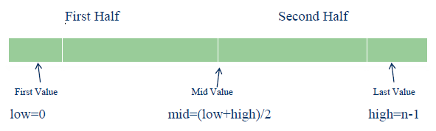
Binary Search
This technique works better on sorted arrays and can be applied only on sorted arrays.
Not applied on Linked Lists.
Requires less number of comparisons than linear search.
Efficiency: O(log2n).
Logic behind the technique:

Slide 6
Hashing

Slide 7
Why Hashing?
The sequential search algorithm takes time proportional to the data size, i.e. O(n).
Binary search improves on liner search reducing the search time to O(log n).
With a BST, an O(log n) search efficiency can be obtained; but the worst-case complexity is O(n).
To guarantee the O(log n) search time, BST height balancing is required ( i.e., AVL trees).

Slide 8
Why Hashing?
Suppose that we want to store 10,000 students records (each with a 5-digit ID) in a given container.
A linked list implementation would take O(n) time.
A height balanced tree would give O(log n) access time.
Using an array of size 100,000 would give O(1) access time but will lead to a lot of space wastage.
Is there some way that we could get O(1) access without wasting a lot of space?
The answer is hashing.

Slide 9
Hashing
Hashing is a technique that is used to uniquely identify a specific object from a group of similar objects.
Some examples of how hashing is used in our lives include:
In universities, each student is assigned a unique roll number that can be used to retrieve information about them.
In libraries, each book is assigned a unique number that can be used to determine information about the book, such as its exact position in the library or the users it has been issued to etc.
In both these examples the students and books were hashed to a unique number.

Slide 10
Hashing Contd.
Assume that you have an object and you want to assign a key to it to make searching easy.
To store the key/value pair, you can use a simple array like a data structure where keys (integers) can be used directly as an index to store values.
However, in cases where the keys are large and cannot be used directly as an index, you should use hashing.

Slide 11
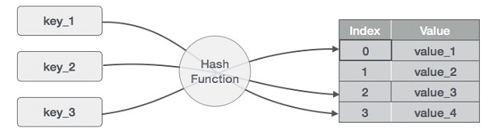
Hashing Contd.

Slide 12
Hashing Contd.
In hashing, large keys are converted into small keys by using hash functions.
The values are then stored in a data structure called hash table.
The idea of hashing is to distribute entries (key/value pairs) uniformly across an array.
Each element is assigned a key (converted key).
By using that key you can access the element in O(1) time. Using the key, the algorithm (hash function) computes an index that suggests where an entry can be found or inserted.

Slide 13
Hashing Contd.
Hashing is implemented in two steps:
An element is converted into an integer by using a hash function. This element can be used as an index to store the original element, which falls into the hash table.
The element is stored in the hash table where it can be quickly retrieved using hashed key.
hash = hashfunc(key)
index = hash % array_size

Slide 14
Advantage
The main advantage of hash tables over other table data structures is speed.
This advantage is more apparent when the number of entries is large (thousands or more).
Hash tables are particularly efficient when the maximum number of entries can be predicted in advance, so that the bucket array can be allocated once with the optimum size and never resized.

Slide 15
Hash Function
A hash function is any function that can be used to map a data set of an arbitrary size to a data set of a fixed size, which falls into the hash table.
The values returned by a hash function are called hash values, hash codes, hash sums, or simply hashes.
To achieve a good hashing mechanism, It is important to have a good hash function with the following basic requirements:
Easy to compute
Uniform distribution
Less Collision

Slide 16
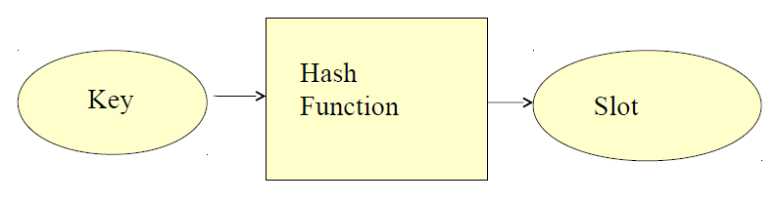
Hash Function
How to deal with Hashing non integer Key???
Find some way of turning keys into integer. e.g. if key is in character then convert it into integer using ASCII
Then use standard Hash Function on the integer.

Slide 17
Hash Function Method
Division Hash Method - The key K is divided by some number m and the remainder is used as the hash address of K.
h(k)=k mod m
This gives the indexes in the range 0 to m-1 so the hash table should be of size m
Generally a prime number is a best choice which will spread keys evenly.

Slide 18
Hash Function Method Contd.
The Folding Method - The key K is partitioned into a number of parts ,each of which has the same length as the required address with the possible exception of the last part .
The parts are then added together , ignoring the final carry, to form an address.
Example:
If key = 356942781 is to be transformed into a three digit address.
P1=356, P2=942, P3=781 are added to yield 079.

Slide 19
Hash Function Method Contd.
The Mid-Square Method - The key K is multiplied by itself and the address is obtained by selecting an appropriate number of digits from the middle of the square.
The number of digits selected depends on the size of the table.
Example: If key=123456 is to be transformed.
(123456)²=15241383936
If a three-digit address is required, positions 5 to 7 could be chosen giving address 138.

Slide 20
Hashing a String
Table size [0..99]
A..Z ---> 1,2, ...26
0..9 ----> 27,...36
Key: CS1 --->3+19+28 (concat) = 31,928
(31,928)2 = 1,019,397,184 - 10 digits
Extract middle 2 digits (5th and 6th) as table size is 0..99.
Get 39, so: H(CS1) = 39.

Slide 21
Hash Table
A hash table is a data structure that is used to store keys/value pairs. It uses a hash function to compute an index into an array in which an element will be inserted or searched.
By using a good hash function, hashing can work well. Under reasonable assumptions, the average time required to search for an element in a hash table is O(1).

Slide 22
Hash Table Operations
Search: compute f(k) and see if a pair exists
Insert: compute f(k) and place it in that position
Delete: compute f(k) and delete the pair in that position
In ideal situation, hash table search, insert or delete takes O(1)

Slide 23
Collision resolution techniques
If x1 and x2 are two different keys, it is possible that h(x1) = h(x2). This is called a collision. Collision resolution is the most important issue in hash table implementations.
Choosing a hash function that minimizes the number of collisions and also hashes uniformly is another critical issue.
Separate chaining (open hashing)
Linear probing (open addressing or closed hashing)
Quadratic Probing
Double hashing

Slide 24
Separate Chaining (Open Hashing)
Separate chaining is one of the most commonly used collision resolution techniques.
It is usually implemented using linked lists. In separate chaining, each element of the hash table is a linked list.
To store an element in the hash table you must insert it into a specific linked list.
If there is any collision (i.e. two different elements have same hash value) then store both the elements in the same linked list.

Slide 25
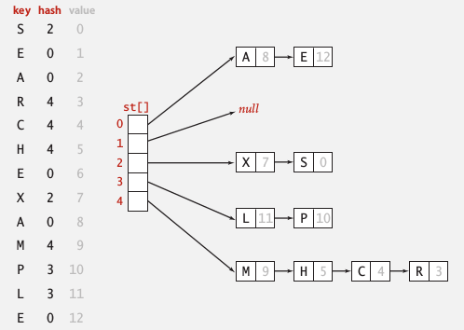
Separate Chaining (Open Hashing)

Slide 26
Linear Probing
In open addressing, instead of in linked lists, all entry records are stored in the array itself.
When a new entry has to be inserted, the hash index of the hashed value is computed and then the array is examined (starting with the hashed index).
If the slot at the hashed index is unoccupied, then the entry record is inserted in slot at the hashed index else it proceeds in some probe sequence until it finds an unoccupied slot.

Slide 27
Linear Probing Contd.
The probe sequence is the sequence that is followed while traversing through entries. In different probe sequences, you can have different intervals between successive entry slots or probes.
When searching for an entry, the array is scanned in the same sequence until either the target element is found or an unused slot is found. This indicates that there is no such key in the table. The name "open addressing" refers to the fact that the location or address of the item is not determined by its hash value.

Slide 28
Linear Probing Contd.
Linear probing is when the interval between successive probes is fixed (usually to 1). Let’s assume that the hashed index for a particular entry is index. The probing sequence for linear probing will be:
index = index % hashTableSize
index = (index + 1) % hashTableSize
index = (index + 2) % hashTableSize
index = (index + 3) % hashTableSize

Slide 29
Linear Probing Contd.
Linearprobeinsert(k)
If(table is full) {error}
probe =h(k)
while(table[probe] is occupied)
{
probe = (probe + 1) % m //m is no. of slots
}
Table[probe]=k

Slide 30
Linear Probing Contd.
Example:
H(k) = k mod 13
Insert keys : 18 41 22 44 59 32 31 73
H(18) = 18 mod 13
H(18) = 5
18
0
1
2
3
4
5
6
7
8
9
10
11
12

Slide 31
Linear Probing Contd.
Example:
H(k) = k mod 13
Insert keys : 18 41 22 44 59 32 31 73
H(41) = 41 mod 13
H(41) = 2
41
18
0
1
2
3
4
5
6
7
8
9
10
11
12

Slide 32
Linear Probing Contd.
Example:
H(k) = k mod 13
Insert keys : 18 41 22 44 59 32 31 73
H(22) = 22 mod 13
H(22) = 9
41
18
22
0
1
2
3
4
5
6
7
8
9
10
11
12

Slide 33
Linear Probing Contd.
Collision!!
Example:
H(k) = k mod 13
Insert keys : 18 41 22 44 59 32 31 73
H(44) = 44 mod 13
H(44) = 5
41
18
44
22
0
1
2
3
4
5
6
7
8
9
10
11
12

Slide 34
Linear Probing Contd.
Example:
H(k) = k mod 13
Insert keys : 18 41 22 44 59 32 31 73
H(59) = 59 mod 13
H(59) = 7
41
18
44
59
22
0
1
2
3
4
5
6
7
8
9
10
11
12

Slide 35
Linear Probing Contd.
Collision!!
Example:
H(k) = k mod 13
Insert keys : 18 41 22 44 59 32 31 73
H(32) = 32 mod 13
H(32) = 6
41
18
44
59
32
22
0
1
2
3
4
5
6
7
8
9
10
11
12

Slide 36
Linear Probing Contd.
Collision!!
Example:
H(k) = k mod 13
Insert keys : 18 41 22 44 59 32 31 73
H(31) = 31 mod 13
H(31) = 5
41
18
44
59
32
22
31
0
1
2
3
4
5
6
7
8
9
10
11
12

Slide 37
Linear Probing Contd.
Collision!!
Example:
H(k) = k mod 13
Insert keys : 18 41 22 44 59 32 31 73
H(73) = 73 mod 13
H(73) = 8
41
18
44
59
32
22
31
73
0
1
2
3
4
5
6
7
8
9
10
11
12

Slide 38
Double Hashing
Double hashing is similar to linear probing and the only difference is the interval between successive probes. Here, the interval between probes is computed by using two hash functions.
h1(k) - Position in the table where we first check for the key.
h2(k) – Determine offset when h1(k) is already occupied.
In Linear probing, what was the offset?
Offset - 1.

Slide 39
Double Hashing Contd.
Doublehashing insert(k)
If (table is full) {error}
Probe=h1(k);
offset=h2(k);
While (table[probe] is occupied)
{
probe=(probe + offset)%m //m is no. of slots
}
table[probe]=k;

Slide 40
Double Hashing Contd.
Example:
H1(k) = k mod 13
H2(k) = 8 – (k mod 8)
Insert keys : 18 41 22 44 59 32 31 73
H1(18) = 18 mod 13
H1(18) = 5
18
0
1
2
3
4
5
6
7
8
9
10
11
12

Slide 41
Double Hashing Contd.
Example:
H1(k) = k mod 13
H2(k) = 8 – (k mod 8)
Insert keys : 18 41 22 44 59 32 31 73
H1(41) = 41 mod 13
H1(41) = 2
41
18
0
1
2
3
4
5
6
7
8
9
10
11
12

Slide 42
Double Hashing Contd.
Example:
H1(k) = k mod 13
H2(k) = 8 – (k mod 8)
Insert keys : 18 41 22 44 59 32 31 73
H1(22) = 22 mod 13
H1(22) = 9
41
18
22
0
1
2
3
4
5
6
7
8
9
10
11
12

Slide 43
Double Hashing Contd.
Again Collision!!
Collision!!
Example:
H1(k) = k mod 13
H2(k) = 8 – (k mod 8)
Insert keys : 18 41 22 44 59 32 31 73
H1(44) = 44 mod 13
H1(44) = 5
H2(44) = 8 – ( 44 mod 8)
H2(44) = 4
44
41
18
22
0
1
2
3
4
5
6
7
8
9
10
11
12

Slide 44
Double Hashing Contd.
Example:
H1(k) = k mod 13
H2(k) = 8 – (k mod 8)
Insert keys : 18 41 22 44 59 32 31 73
H1(59) = 59 mod 13
H1(59) = 7
44
41
18
59
22
0
1
2
3
4
5
6
7
8
9
10
11
12

Slide 45
Double Hashing Contd.
Example:
H1(k) = k mod 13
H2(k) = 8 – (k mod 8)
Insert keys : 18 41 22 44 59 32 31 73
H1(32) = 32 mod 13
H1(32) = 6
44
41
18
32
59
22
0
1
2
3
4
5
6
7
8
9
10
11
12

Slide 46
Double Hashing Contd.
Collision!!
Collision!!
Collision!!
H1(31) = 31 mod 13
Example:
H1(k) = k mod 13
H2(k) = 8 – (k mod 8)
Insert keys : 18 41 22 44 59 32 31 73
H1(31) = 5
H2(31) = 8 – (31 mod 8)
H2(31) = 1
44
41
18
32
59
31
22
0
1
2
3
4
5
6
7
8
9
10
11
12

Slide 47
Double Hashing Contd.
Collision!!
H1(73) = 73 mod 13
Example:
H1(k) = k mod 13
H2(k) = 8 – (k mod 8)
Insert keys : 18 41 22 44 59 32 31 73
H1(73) = 8
H2(73) = 8 – (73 mod 8)
H2(73) = 7
44
41
73
18
32
59
31
22
0
1
2
3
4
5
6
7
8
9
10
11
12

Slide 48
Quadratic Probing
Quadratic probing is similar to linear probing and the only difference is the interval between successive probes or entry slots.
Here, when the slot at a hashed index for an entry record is already occupied, you must start traversing until you find an unoccupied slot.
The interval between slots is computed by adding the successive value of an arbitrary polynomial in the original hashed index.

Slide 49
Quadratic Probing Contd.
Let us assume that the hashed index for an entry is index and at index there is an occupied slot. The probe sequence will be as follows:
index = index % hashTableSize
index = (index + 1²) % hashTableSize
index = (index + 2²) % hashTableSize
index = (index + 3²) % hashTableSize

Slide 50
Application
Associative arrays: Hash tables are commonly used to implement many types of in-memory tables. They are used to implement associative arrays (arrays whose indices are arbitrary strings or other complicated objects).
Database indexing: Hash tables may also be used as disk-based data structures and database indices (such as in dbm).
Caches: Hash tables can be used to implement caches i.e. auxiliary data tables that are used to speed up the access to data, which is primarily stored in slower media.
Object representation: Several dynamic languages, such as Perl, Python, JavaScript, and Ruby use hash tables to implement objects.
Hash Functions are used in various algorithms to make their computing faster.

Slide 51
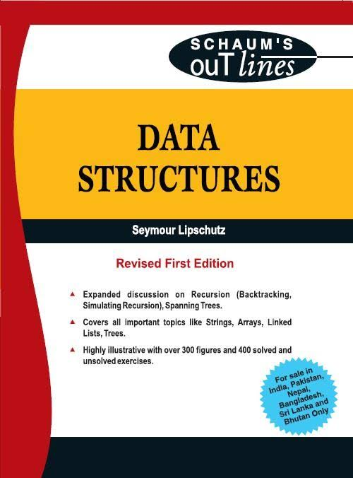
References
“Data Structures” by Seymour Lipschutz (Schaum’s Outline Series in Computer)
Online Materials

Slide 52
Thank You..!

